Slide 1

Underground Fuel Depot V5
Michael

Slide 2
Proposed project plan
DATE | TASK | ASSIGNED TO | DURATION(Days) | EXPECTED TIME OF COMPLETION / ARRIVAL | TASK | DEPENDENCIES
1-Dec | Tank restoration and preparation to receive ethanol, removal of existing pump and building of suitable canopy | VIVO ENGINEERS AND CONTRACTORS | 7 | 8-Dec | A | NONE
1-Dec | Procurement of fittings and components for retrofit | MICHAEL | 5 | 6-Dec | B | NONE
30-Nov | HSEQ SOPs and Checklists,Risk Assessment of the station and impending developments | DOUGLAS | 3 | 3-Dec | C | NONE
30-Nov | FD System cabinet design and fabrication | PETER | 5 | 5-Dec | D | NONE
29-Nov | FD system assembly and STS SOFTWARE testing at existing Above ground Tank | MICHAEL M. AND MICAEL(Sam Njenga, Collins W, Brian, Kevin) | 6 | 5-Dec | E | NONE
5-Dec | KOKO FD system fit out into cabinet and testing at Loresho | MICHAEL AND PETER | 1 | 6-Dec | F | D
7-Dec | FD Assembly transfered to VIVO station and assembled at the existing pump site including fitting out vent pipes and any additional fitout like Fire suppression equipment | MICHAEL, PETER | 1 | 8-Dec | G | D,F
8-Dec | Ethanol transfer from existing storage to vivo station using MT and parking the same at station | MICHAEL | 3 | 11-Dec | H | A,G
13-Dec | Internal Demos and system verification testing | MICHAEL | 2 | 15-Dec | I | H
17-Dec | Roll out Pilot to VIvo | MICHAEL, SAGUN | 0 | 17-Dec | J | I
30-Nov | ATG sourcing, installation and integration to KOKO systems | MICAEL and MICHAEL | 30 | 30-Dec | K | A-J

Slide 3
WHAT IS A KOKO FUEL DEPOT(FD)
Koko fuel depot is ethanol underground storage fashioned in the same way as petroleum tank storages in petrol stations.
We wish to introduce a system that will reduce human interaction considerably in the product handling and inventory management of the fuel(Ethanol).
The koko depot will serve as an intermediate storage for ethanol close enough to our final vending points which are the KOKO points. It is not a retail point as it is used in the Oil and Gas setup and therefore only authorised koko personnel will access the same and there is no requirement on our partner to provide staff for these system.

Slide 4
FD business case
KOKO FD is a logistically sound method considering our operational areas which are traffic prone to ensure no dry outs at KOKO points.
The capacity (20000litres ) allows the FD to serve several Milk run trucks and by extension KOKO points before restocking is required .
Instead of our partner incurring additional investment(20000USD) in sinking new underground storage our partner can simply convert existing unused tankage(2500USD) in existing petrols stations to not only meet our need but also provide additional revenue to our partner.
The system is designed in such a way that other than initial infrastructure there is minimum operating expenditure as it does not require any additional human investment to manage it.

Slide 5
What our FD will do:
Apart from the normal operation of dispensing metered fuel our FD should be able to:
Allow us to operate the pumping unit remotely once the delivery piping is coupled to our pumping unit.
Give us an accurate representation of quantities delivered from and loaded into the tank.
Allow us to remotely diagnose any faults with our dispensing system
Prevent any unsafe usage of equipment by integrating a safety protocol in its operation
Regularly update us on tank stocks and any entry of contaminants into the tank
Mimic normal oil facility operations to allow integration to mainstream Oil and Gas or other industrial bulk storage outfits without too much retrofit.

Slide 6
FUEL DEPOT(FD) High Level Design
Underground tank done to required fuel standards,
Piping to allow coupling to koko smart system
Pump shed with a booth that provide mounting points for two fire extinguishers.
Clear labelling identifying the product and provide clear guidance of the product contained and mitigation to prevent incidences(HAZMAT SIGN)
Intrinsically safe lighting in the container to allow late evening or early morning operations where there is limited illumination.
Provide for vapour recovery and pressure relief mechanism
Tank manhole to allow maintenance and periodic tank cleaning as and when scheduled
Comprised of available commercially ethanol dispensers with dispense volume pre sets . This allows us to incorporate systems with proven HSE aspects into our build.
KOKO smart system (Sensors and controls) sits between the pumping unit and the underground storage tank(UST) as well as and provides KOKO and KOKO systems complete visibility and control of inventory movement as well as tracking into and out of the UST.

Slide 7
MICRO TANKER SPECS
ITEM | DESCRIPTION
Truck | A truck that can haul up to 4 tons cargo powere by 2 12V batteries together with battery cut off switch ISUZU NPR TRUCK(7.5TON)
Tankage/capacity | 3mm with 4mm end plates Mild steel tank made to API 650 standards 3500 litres capacity branded with 2 inch delivery line with a ball valve. 20 inch top dome with concentric 1 inch, 2 inch threaded opening for our controls to be introduced. Has a 2 inch pressure relief vent provided and calibrated wet calibrated on after mounting on truck. TANK MADE NAD MONUTED ON TRUCK BY WARREN ENTERPRISES
Cabinet | 1.5 or 2mm thick mild steel lockable cabinet to hold our controls and pumping assembly
Pump and Meter specs | MINI FUEL DISPENSER FIMETER MODEL BJJ-20-A6B(DC 12V , 24V)Flow rate 20 to 80 litres per minute, 0.5KW rating http://www.finemeter.com/tanker/1507.html
Delivery Lines | ¾” delivery hoses for vapour and liquid. Wire reinforced Flexible Nitrile rubber fuel delivery hoses 150psi maximum pressure with proper coupling fittings to allow maintenance and
Plumbing fittings | Stainless steel camlock fittings, threaded fittings
Control Firmware | Android Phone, V 2.3 board and cabling(4 core) for level sensor, Ducting and Modem, motorised ball valves
Battery | 12V battery 100AH deep cycle for powering the system
Earthing requirements | Bonding Wire with crocodile clip connectors
Cables and ducting | Armored and shielded cabling with D Connectors and termination lugs all terminating in the rear of the cabinet.
Safety Consideration including Fire Suppression system, signages | 2 9kg fire extinguishers, 4 traffic cones, wheel chocks, truck reflectors Spark arrestor, hazmat signs A2 in size, Pressure relief valves, swing check valve

Slide 8
Fuel Depot system SPECS
ITEM | DESCRIPTION
Underground Tank UST | 6mm thick MS tank with bituminous coating sunk underground based on Petroleum standards in kenya with 2” vent, 4” inlet and a 2” dipping tube on 600mm dome cover
Pump | Off the shelf Fimeter BJJ-20-ah1/AH1D Average flow rate 48 lpm at a head of 3m. Flow meter Accuracy to 0,01 litres and error 0.2% ATEX certified for use in zone 0 areas. T4 antiexplosion and F Class insulation http://www.finemeter.com/tanker/362.html
Delivery Line Fuel | 2 inch reduced to ¾” delivery lines for vapour and liquid. Flexible reinforced with proper coupling fittings to allow maintenance and manoeuvrability
Return vapour line | 2” line to be coupled to the 4” off loading point using a 4-2” reducer camlock during MT refilling Flexible reinforced with proper coupling fittings to allow maintenance and manoeuvrability
Plumbing fittings and Plumbing | GI and Stainless steel 304 camlock fittings, TYPE C, D,
Pressure relief and Vacuum relief system | https://www.flowstarvalveshop.com/collections/all/products/niezgodka-type-90-combined-vacuum-pressure-relief-valve 2” Stainless steel PRV and VRV with a vacuum rating -0.01 bar gauge and pressure rating of up to 0.5Bar gauge rating
Control hardware | Android tablet, control board and cabling(4 core) for level sensor, Ducting and Modem, solenoid valves, motorised ball valves,
Power requirements | 2KW AC power for the Pump which wil alsol using relays and UPS will stabilized and converted to 12V to support our controls
Cabling in the cabinet fittings | Lighting and armored cabling
Earthing requirements | A 1.5 metre sank copper earthing rod connected to tank via earthing copper strip.
Safety Consideration including Fire Suppression system, signages | 2 portable fire extinguishers and hazmat signs on the cabinet. And spill control berm

Slide 9
Personal Protective equipment(PPE) for operator SPECS
ITEM | DESCRIPTION
Helmet
Overalls
Fuel handling gloves
Equipment handling Gloves
Safety Goggles
Self Respirator
Harness
Safety Shoes
Anti static band

Slide 10
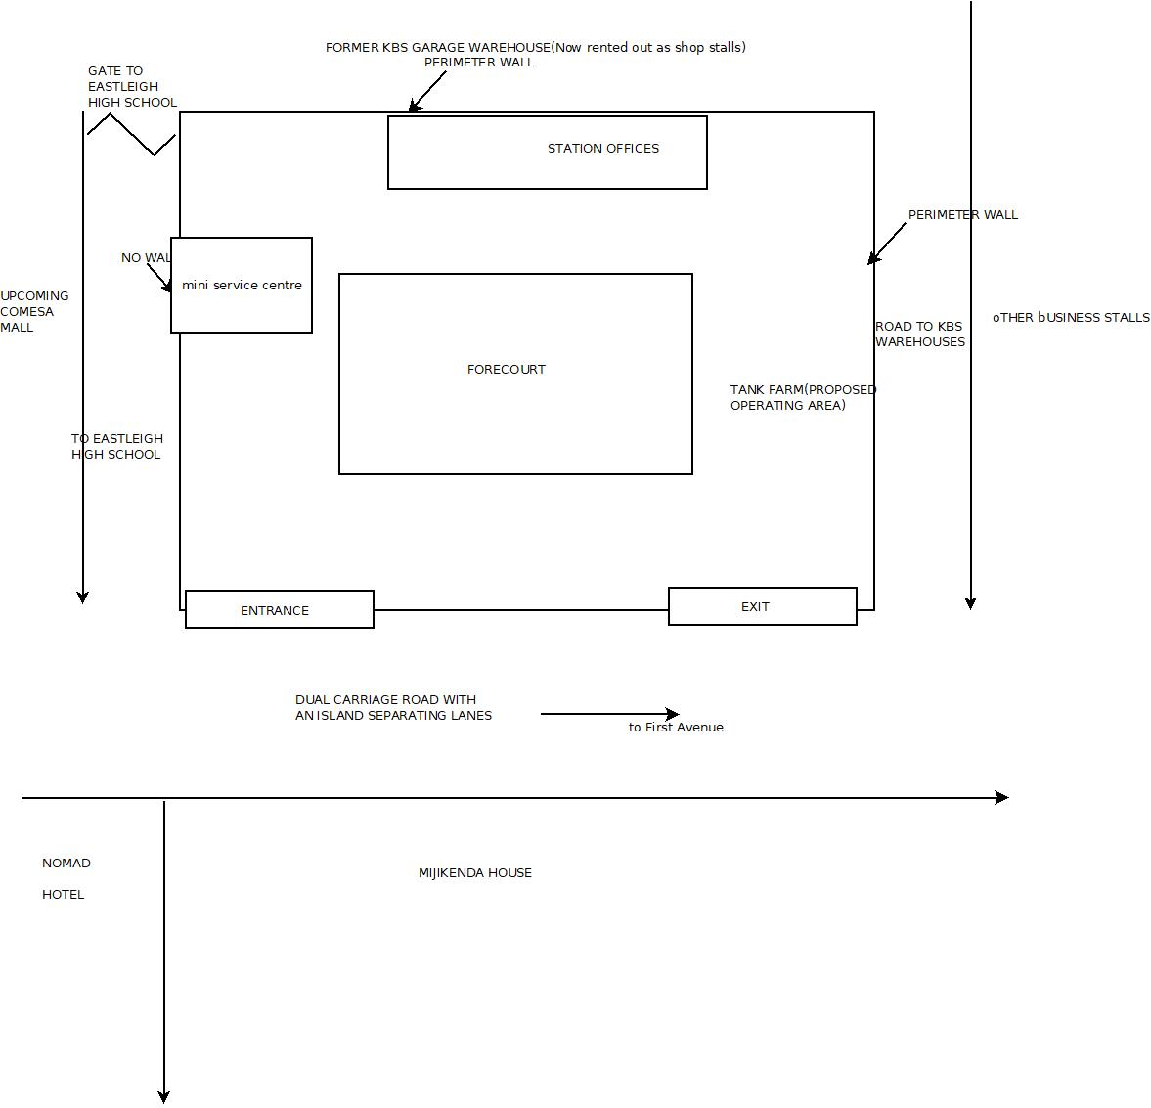
PILOT STATION LAYOUT

Slide 11
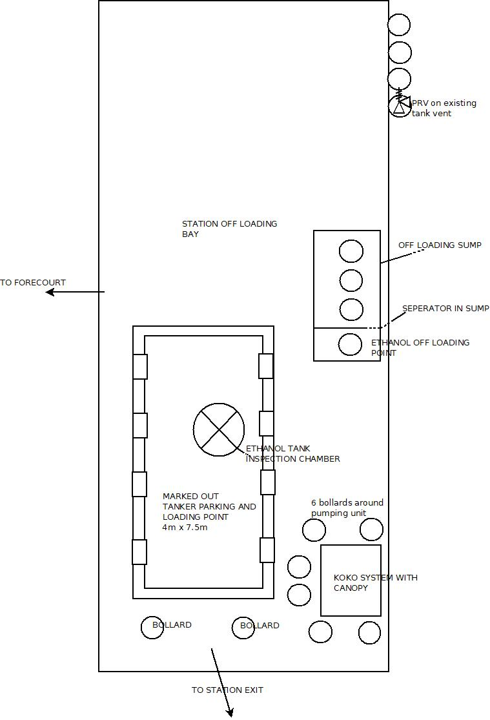
SPECIFIC PILOT AREA BLOW UP

Slide 12
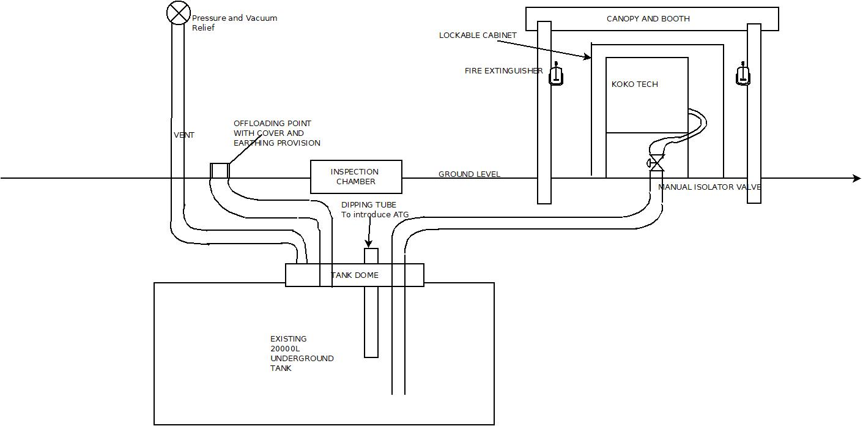
VIVO PILOT
SET UP

Slide 13
Operational Processes
Ethanol receipt procedure
MT refill procedure
MT refill checklist
Emergency response procedures(Spill, Fire, Accident/Incident)(Douglas)
Equipment Maintenance procedure(Peter)
Daily and Monthly stock take procedure

Slide 14
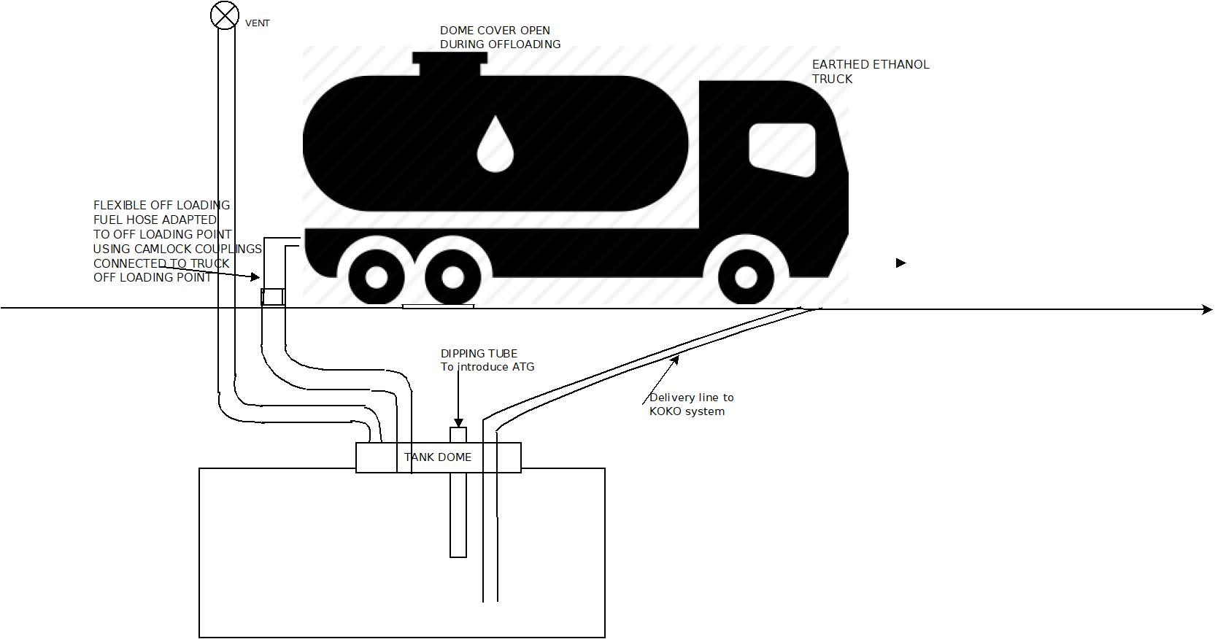
Ethanol Receipt Process

Slide 15
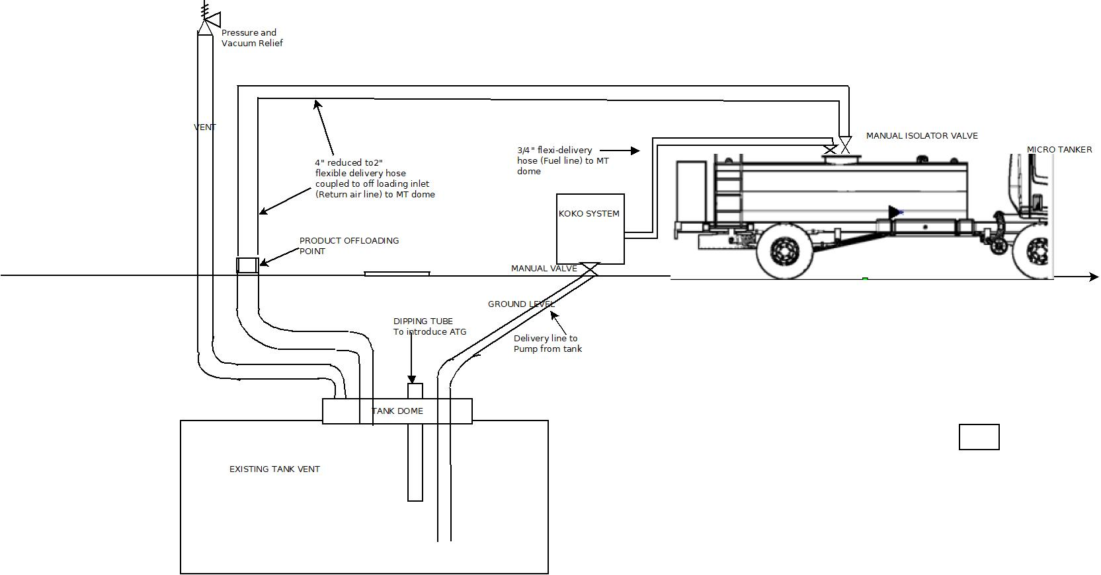
Microtanker Refilling process

Slide 16
FD Checklist Before Usage
Nema and ERC approvals have been acquired
The tank should not evidence leakages, should be water tight, clean and free from any contaminants
Tankage should be properly earthed, vented.
Pump area should have adequate and serviced fire equipment.
Intrinsically safe lighting to have adequate illumination during early or late operations.
Safety signage and SOPs including Emergency response procedure in place.
KOKO system properly installed according to fuel industry installations practices.

Slide 17
Smart Depot System
Smart Depot System performs various functions:
Begins and ends all truck refuelling processes
Helps the Manager(DM) plan for restocking
Notifies the DM on any attempt to interfere with the depot
Notifies DM of stock inadequacy and danger of overfill
Informs DM the status of the equipment in the Depot
Informs DM of safety procedures and emergency response protocol in times of accidents and incidences.

Slide 18
References
The following documents have been referenced
Fuel Depot System
Preliminary visit station findings
Vivo station layout drawings and canopy design
Micro Tanker manual
Guide to explosive atmospheres

